Slide 1





OilMixProp 1.0: Thermophysical Properties of User-Defined Oils, Common Fluids and their Mixtures
Xiaoxian Yang & Markus Richter, Chemnitz University of Technology, Germany

Slide 2
Questions
Question:
Is the software free to use and where to find it?

Slide 3
Availability of OilMixProp
Free to use; but at your own risk.
Contact us to get the software:
  A standalone OilMixProp.exe for Windows
  A coding package in Matlab (more powerful)
On-going: converting to other languages, like C⁺⁺
Bug exists, any feedbacks are highly appreciated!

Slide 4
Questions
Question:
What are the key functions of OilMixProp 1.0?

Slide 5
OilMixProp in a nut shell
Fluid Properties = OilPropm( ‘all+’, 'P', p, 'T', T, Z, FC, T₀, p₀ )
Output indicators:
% ‘All’ all properties
% ‘A’ Speed of sound [m/s] % ‘D’ Density [kg/m³] % ‘H’ Enthalpy [J/kg] % ‘K’ Heat capacity ratio % ‘P’ Pressure [kPa] % ‘Q’ Vapor fraction [kg/kg]
% ‘S’ Entropy [J/(kg⋅K)] % ‘T’ Temperature [K]
% ‘U’ Internal energy [J/kg] % ‘V’ Viscosity [Pa⋅s]
% ‘C’ Isobaric heat capacity [J/(kg⋅K)]
% ‘O’ Isochoric heat capacity [J/(kg⋅K)]
% ‘L’ Thermal conductivity [W/(m⋅K)]
% ‘X’ Liquid & gas phase compositions in mass frac.
% ‘Z’ Compressibility factor
% ‘#’ dP/dT (constant rho) [kPa/K]
% ‘R’ d(rho)/dP (constant T) [kg/m³/kPa]
% ‘W’ d(rho)/dT (constant p) [kg/(m³⋅K)]
% ‘+’ optional, if the fluid is in a single phase
First input and value
% ‘P’ Pressure [kPa]
% ‘T’ Temperature [K]
Z: mass fraction
FC: Fluid constants
% Provide values only if T or p is to be solved and also good estimations are known. This speeds up the calculations.
% Otherwise set zeros
Second input and value:
% ‘P’ Pressure [kPa]
% ‘T’ Temperature [K]
% ‘D’ Density [kg/m³]
% ‘Q’ Vapor fraction [kg/kg]
% ‘H’ Enthalpy [J/kg]
% ‘S’ Entropy [J/kg/K]
A package developed in Matlab
A software package for core thermophysical properties of oils, common fluids and their mixtures.
Inputs and outputs are specially designed for thermodynamic cycle analysis (heat pump, etc.)
First one capable of calculating all the core thermophysical properties of fluids involving user-defined oils

Slide 6
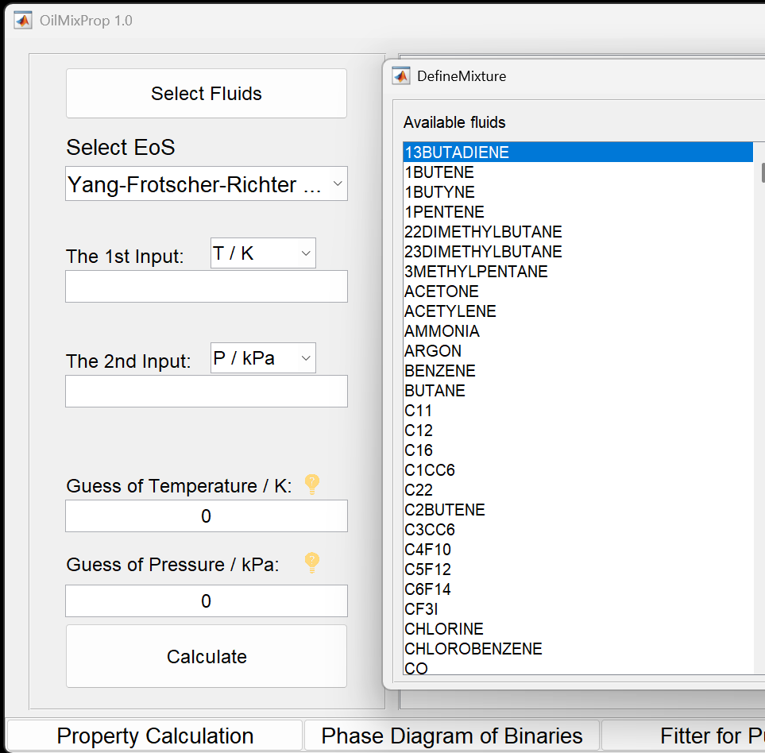



Fluids in OilMixProp
632 pure fluids, and ~1500 in the next version.
Get the complete list of fluids
  Coding package:
  run: f_fluidname(‘all’) in in Get_FluidNames.m
  With a GUI:
The adopted name of a fluid in coding package, run
f_fluidname(‘CAS Registry Number’) in Get_FluidNames.m
e.g., f_fluidname(‘124-38-9’)

Slide 7
Fundamentals
Key thermophysical properties Semi-physically semi-empirical models
Density
Liquid-Vaper-Equilibria
Residual properties
Heat capacity
Entropy
Enthalpy
Speed of sound
Viscosity
Thermal conductivity
Cubic equation of state (EoS)
+ van der Waals (vdW) mixing rule
Cubic EoS + c_{p}º as a linear function of temperature
c_{p}º: ideal gas isobaric heat capacity
Cubic EoS + Residual entropy scaling (RES) of Yang et al
Yang, X., Hanzelmann, C., Feja, S., Trusler, J. M., & Richter, M. (2023). Thermophysical Property Modeling of Lubricant Oils and Their Mixtures with Refrigerants Using a Minimal Set of Experimental Data. Industrial & Engineering Chemistry Research, 62(44), 18736–18749.
Yang, X.; Richter, M. Thermophysical Property Model of Lubricant Oils and Their Mixtures with Refrigerants. In 2024 Herrick Conferences; West Lafayette, IN, USA, 2024.
Yang, X.; Richter, M. OilMixProp 1.0: Package for Thermophysical Properties of Oils, Common Fluids, and Their Mixtures. IOP Conf. Ser.: Mater. Sci. Eng. 2024, 1322 (1), 012009. https://doi.org/10.1088/1757-899X/1322/1/012009.

Slide 8
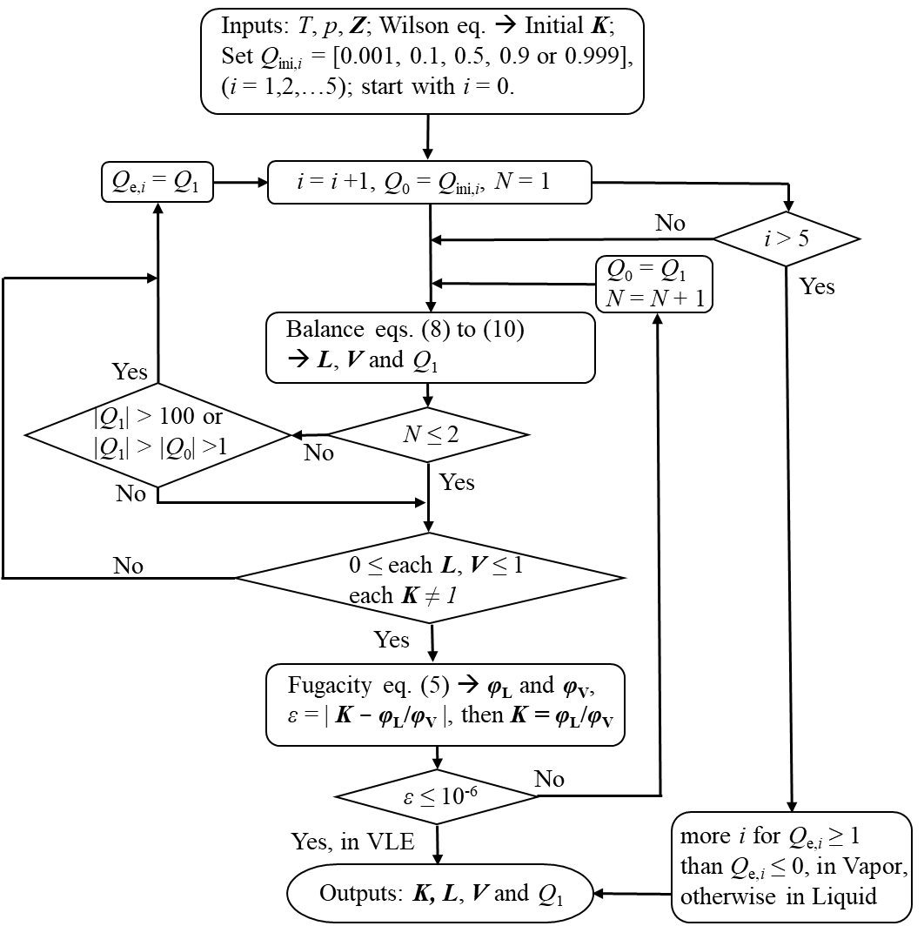
Liquid-vapor equilibrium
A robust flash algorithm for liquid-vapor equilibrium
Liquid-liquid-vapor equilibrium in the next version
Solid-liquid-liquid-vapor equilibrium in future versions

Slide 9
REFPROP and OilMixProp
REFPROP 10.0 can be implemented in OilMixProp 1.0.
If you have the license to use REFPROP, copy-paste REFPRP64.dll to the folder: [path of the installed package]/classes/. Or contact us for help
Use OilMixProp results if fluids in two or more phases.
Use REFPROP results if fluids in the single phase.
The 150 fluids available in REFPROP, run
f_fluidname(‘REFPROP’) in Get_FluidNames.m

Slide 10
Questions
Question:
Can you briefly explain the important files and folders in the package?

Slide 11
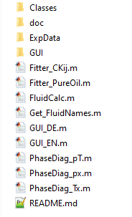
Package structure
All subroutines and parameter files
Literature and fundamentals
Experimental data of user-defined oils
Files for graphical user interface
Main functions
Summary of how to use the software package

Slide 12
Questions
Question:
How to calculate thermophysical properties of fluids using OilMixProp?

Slide 13
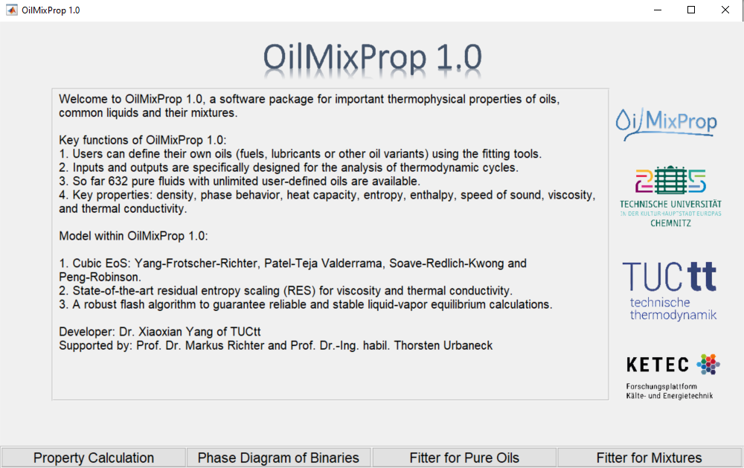
Fluid property calculation

Slide 14
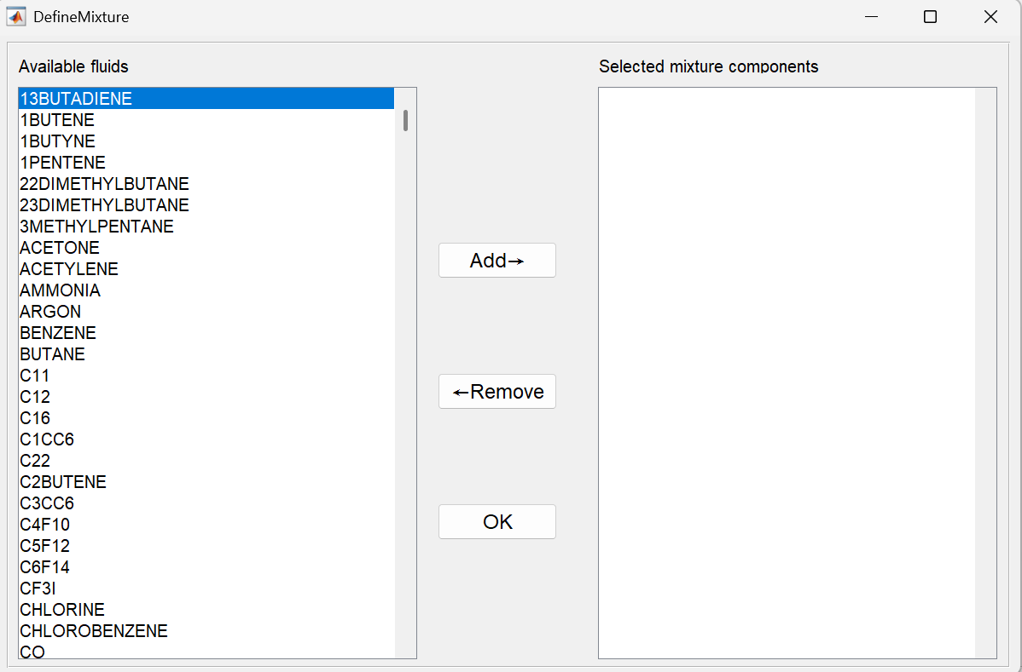
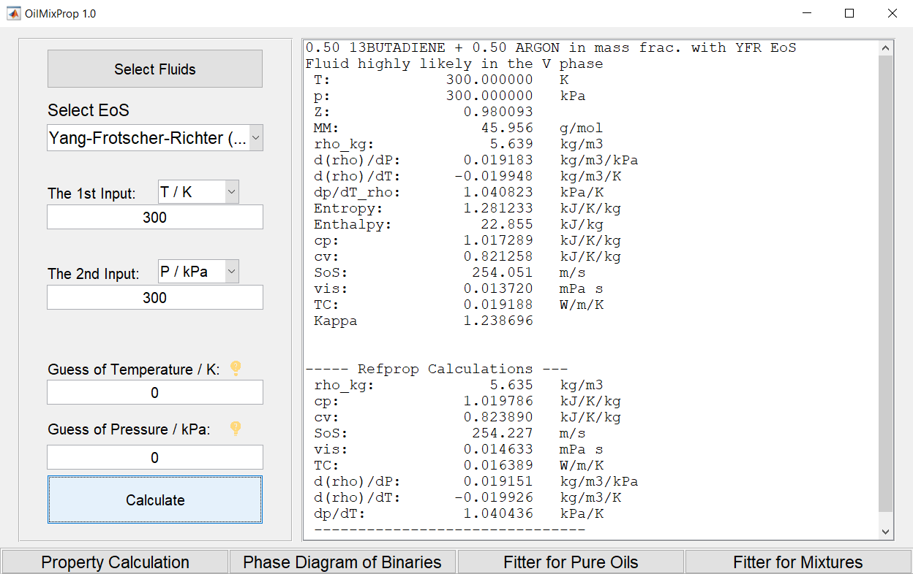


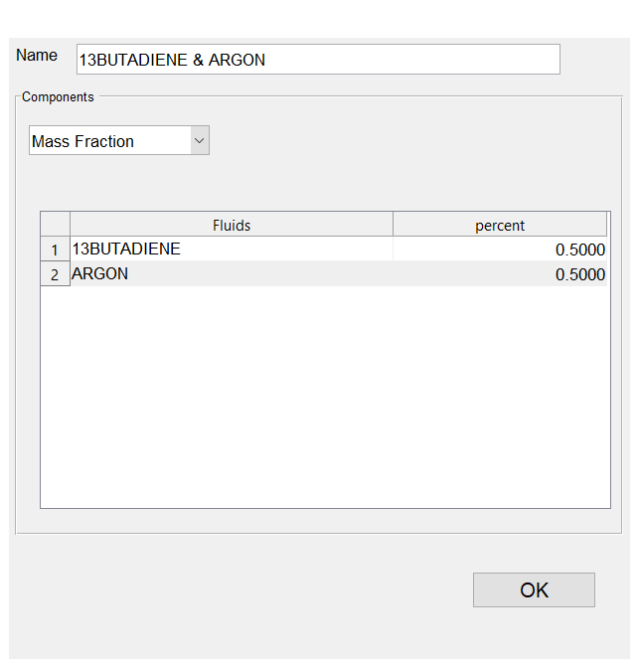

Example calculation (1)

Slide 15
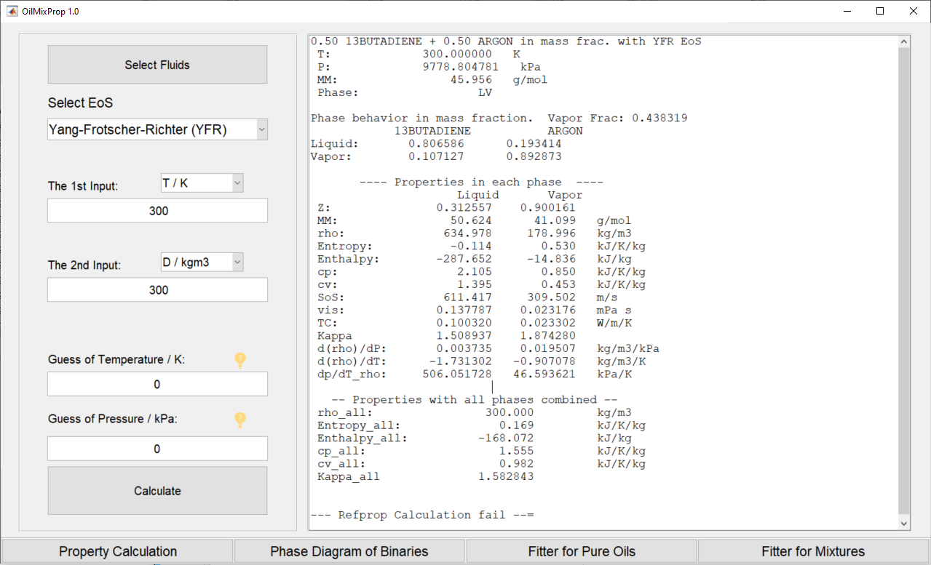
Example calculation (2)

Slide 16
Questions
Question:
Can OilMixProp plot some phase diagrams?

Slide 17
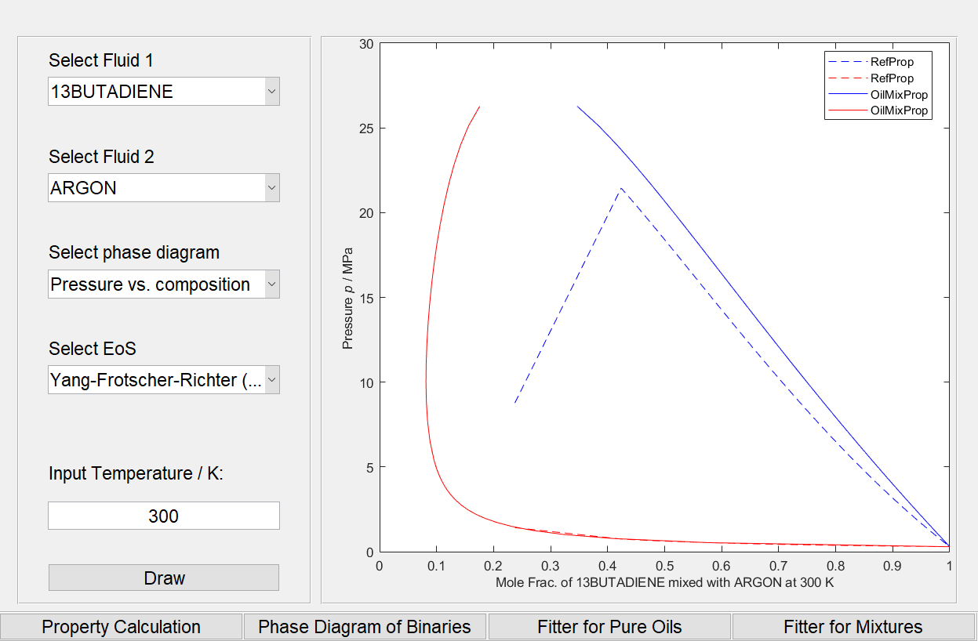
Phase diagrams

Slide 18
Questions
Question:
The software is called OilMixProp, so how can oil be calculated?

Slide 19
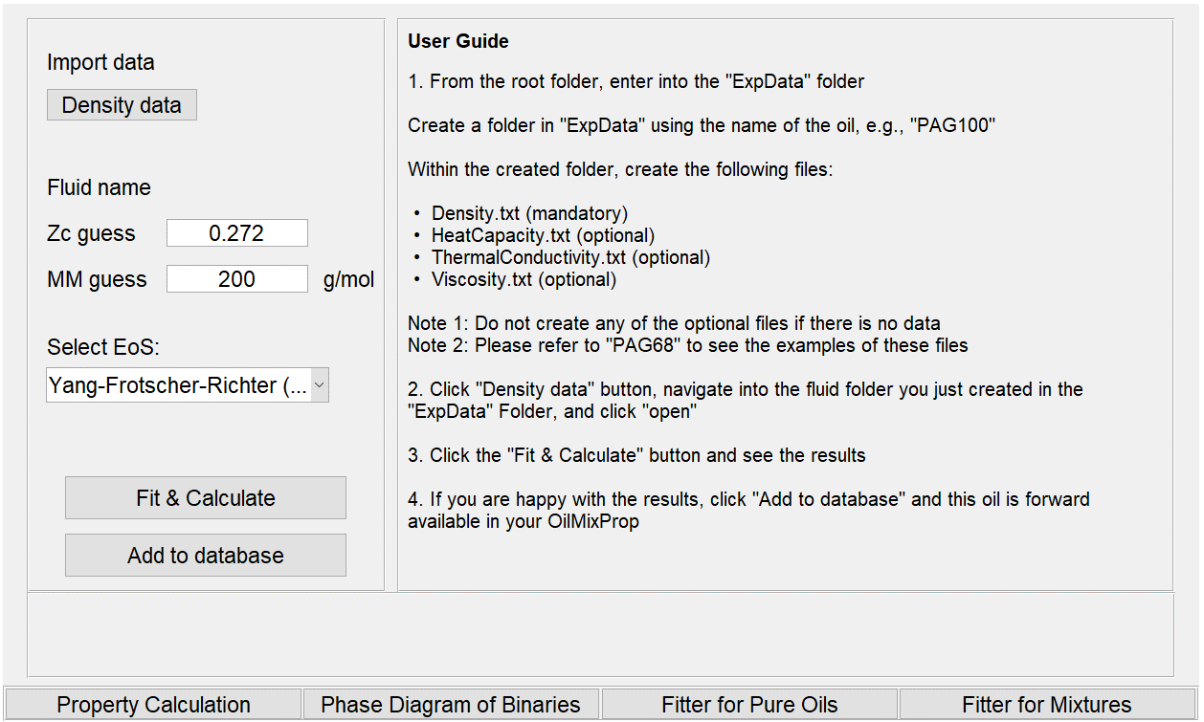
Oil calculation and implementation
Read here carefully
Currently available oils, run:
f_fluidname(‘oils’)
in Get_FluidNames.m

Slide 20
Questions
Question:
How to calculate oil mixtures?

Slide 21
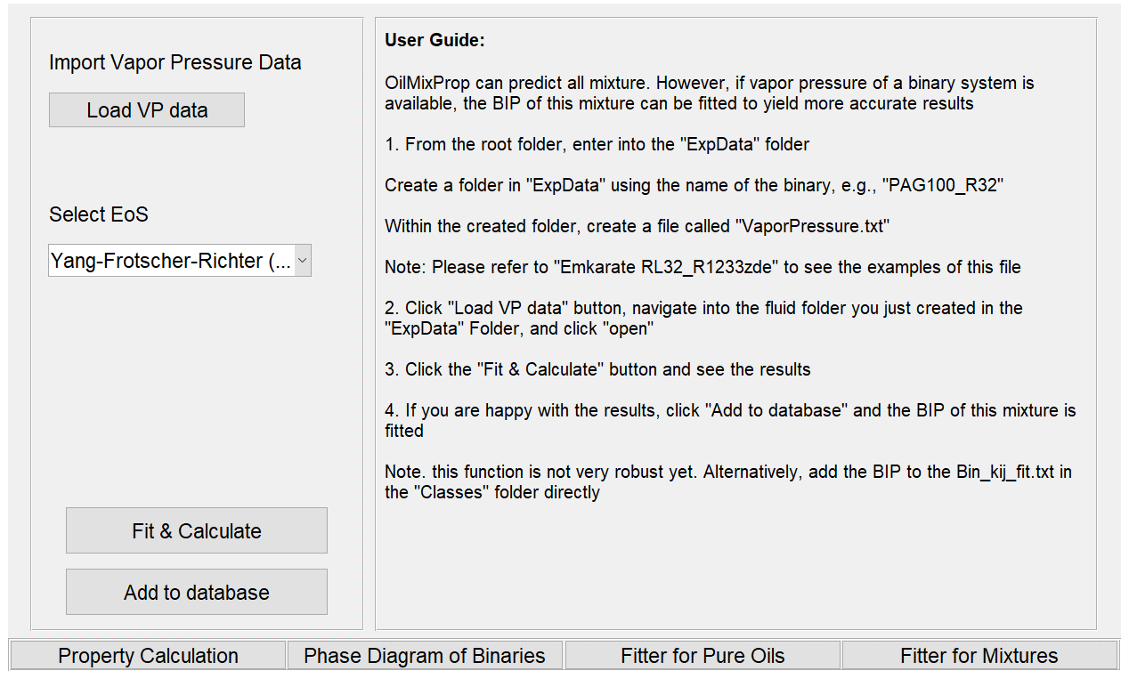
Mixtures with oils
Read here carefully

Slide 22
Questions
Question:
Any new functions to be expected in the next version?

Slide 23
OilMixProp 2.0
Future developments of OilMixProp includes:
adding functions to calculate critical points of mixtures;
updating constants of some fluids needed for transport property calculations based on the RES
enable more phase diagram plots;
adding solid constants to more fluids so that the LVE phase diagram could be updated to SLVE
development of a graphical user interface (GUI)
converting the package to other languages, e.g., python.
OilMixProp 2.0 is estimated to be released in the middle of 2025.

Slide 24



Acknowledgement
Die Forschungsarbeiten werden mit Mitteln des Bundesministeriums für Bildung und Forschung (BMBF) unter den Kennzeichen 03SF0623A/B/C aufgrund eines Beschlusses des Deutschen Bundestages gefördert. Das Projektmanagement übernimmt der Projektträger Jülich (PtJ). Für die Förderung, Unterstützung und Zusammenarbeit bedanken sich die Autoren sehr.
The underlying joint project is funded by the German Federal Ministry of Education and Research (BMBF) under the number 03SF0623A/B/C on the basis of a resolution of the German Bundestag. Project management is carried out by Projektträger Jülich (PtJ). The responsibility for the content of this publication lies with the authors.

